Slide 1
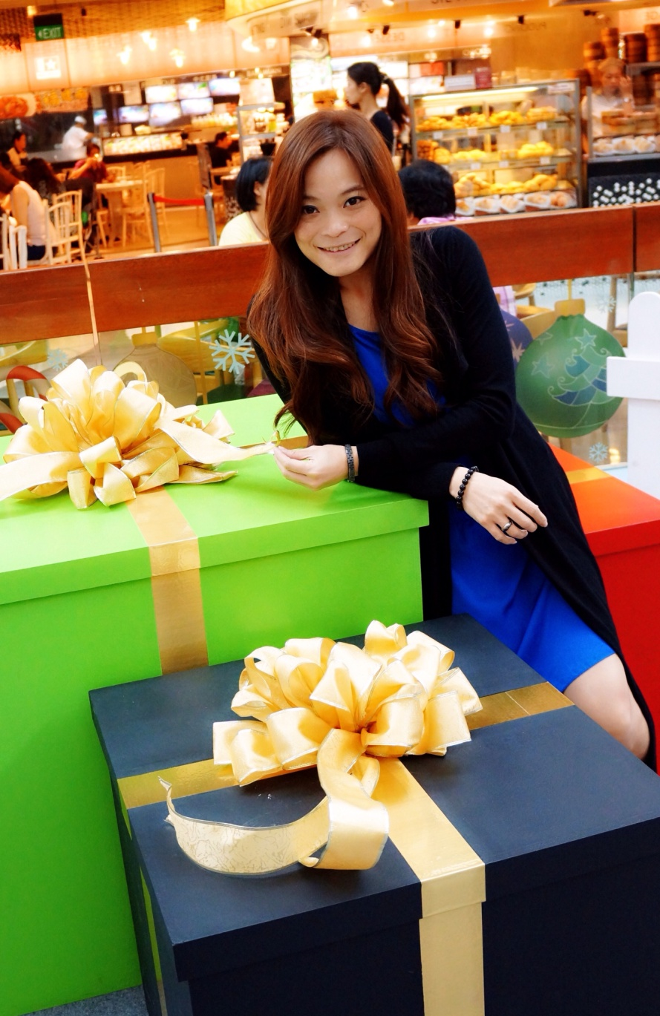
董宥均 Stacy Tung
台北師範教育大學 幼兒教育系畢業
從事幼教工作十年
2005年8月 加入美安台灣公司
目前為執行副總裁級超連鎖店主
™
National Taipei University of Education
Work in preschool education for 10 years
Joined Market Taiwan in Aug,2005
NOW: EFVP
百萬美金俱樂部成員
台灣諮詢評議委員會會員
台灣領導人協會會員
授證訓練員
27 次主管超連鎖店主得主
連續14次總裁挑戰獎
連續12次Motives®挑戰獎
6次網路中心挑戰獎
3次TLS ®挑戰獎
Million Dollar Club member
Market Taiwan S&P
Market Taiwan Leadership Council
Certified Trainer
27 Master UFO qualifier
14 President’s Challenges winner
12 Motives ® Challenges winner
6 WebCenter Challenges winner
3 TLS ® Challenges winner

Slide 2
系統化的複製威力
The Power of Systemic Duplication
Stacy Tung
執行副總裁級 Executive Field Vice-President
四個佣金週期共賺取HK$345,000
HK$345,000 in 4 Commission weeks
本簡報中提到的收入等級純屬舉例說明，無意代表美安香港超連鎖店主的一般收入，也無意表示任何超連鎖店主皆可賺取同等收入。美安香港超連鎖店主的成功與否，取決於其在發展事業時的努力、才能與投入程度。The income levels mentioned in the following presentation are for illustration purposes only. They are not intended to represent the income of a typical Market Hong Kong UnFranchise Owner, nor are they intended to represent that any given Independent UnFranchise Owner will earn income in that amount. The success of any Market Hong Kong Independent UnFranchise Owner will depend upon the amount of hard work, talent, and dedication which he or she devotes to building his or her Market Hong Kong Business.

Slide 3
證實可行的創業系統? A proven business system?
兼差起步?
2~3年計畫?
團隊合作?
購物年金?
永續收入?
Start as a part-time UFO?
2-3 Year Plan?
Teamwork?
Shopping Annuity?
Residual Income?

Slide 4
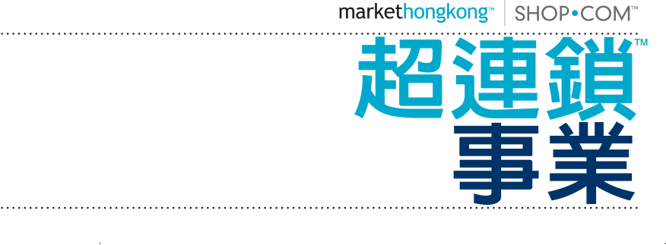
Copyright © 2014 美安集團

Slide 5
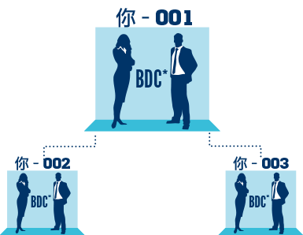
零售商
無需成本，以超連鎖™店主價格購買產品並賺取零售利潤
超連鎖™店主
加入費用
以超連鎖™店主價格購買產品並賺取零售利潤
參與管理業績紅利計劃(MPCP)，賺取佣金
UNFRANCHISE™ OWNER
Subscription Fee
Buy product at Independent UnFranchise™ Owner cost and earn gross retail profit
Participate in the Management Performance Compensation Plan and earn commissions
SALES REPRESENTATIVE
No cost
Buy product at Independent UnFranchise™ Owner cost and earn gross retail profit
*BDC – 商業發展中心

Slide 6
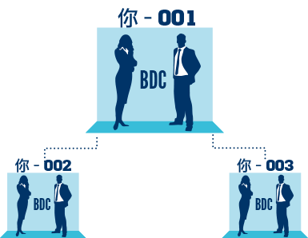
產生BV及IBV的途徑 ：
購買產品自用
自動購貨計劃 ─ 購買產品零售，互聯網行銷，社交媒體
優惠顧客自動送貨計劃
行銷系統
HK.SHOP.COM
印刷資料
一對一行銷
WAYS TO CREATE BV & IBV:
Personal use
Transfer Buying
Retail sales
Preferred Customer AutoShip
Internet Marketing
Social media
HK.SHOP.COM
One-to-One Marketing

Slide 7
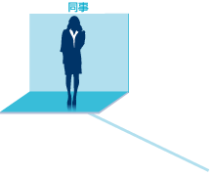
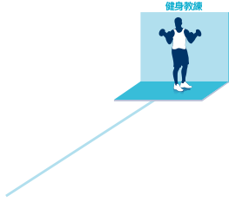
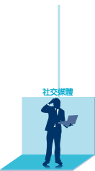
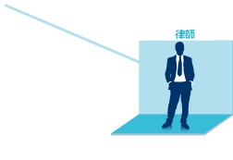
10-15名顧客重複購物
10-15 customers shopping regularly

Slide 8
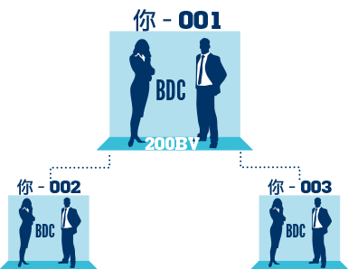
累積200BV使商業發展中心合格，並於左右兩邊開始累積BV及IBV。
商業發展中心合格後，即可開始累積業績點數BV與獎勵業績點數IBV。
Accumulate 200 BV to qualify your Business Development Center (BDC) which opens both your left and right BV and IBV banks.
Once your Business Development Center has been qualified it will begin to accrue Business Volume (BV) and Internet Business Volume (IBV).

Slide 9
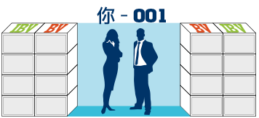
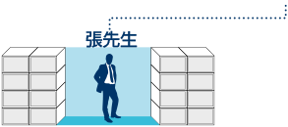
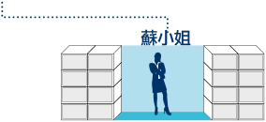
分別於左、右組織個人推薦並放置一名合格超連鎖店主
Personally sponsor and place one qualified UnFranchise™ Owner in your left and right organizations.

Slide 10
現有夥伴帶來夥伴。
People lead to people
*綠色表示個人推薦超連鎖™店主*Green indicates personally sponsored UnFranchise™ Owner

Slide 11
建立、複製、累積甚麼? Create, duplicate, accumulate ?

Slide 12
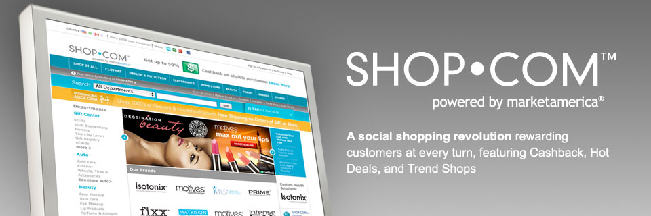
何謂shop.com創業系統? What is shop.com, the Business system?

Slide 13
經營商場SHOP.COM Operating SHOP.COM
社群行銷 & 一對一行銷
Community Marketing & One-to-One Marketing

Slide 14
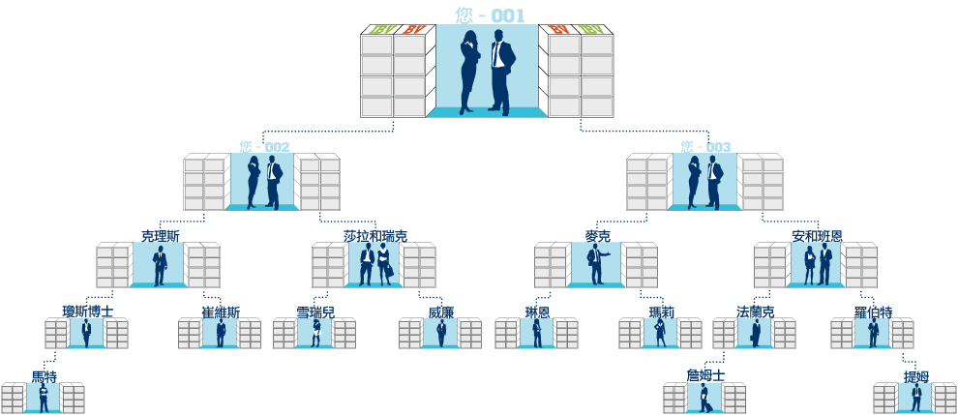
拓展商場SHOP.COM Develop the SHOP.COM
MPCP 超連鎖™事業MPCP – UnFranchise™ Business

Slide 15
輔導超連鎖™店主 To counsel the UFO
新人起步指南
Getting Started Guide

Slide 16
提升專業能力 Enhance professional competence
NMTSS 會議聯盟系統

Slide 17
複製績效 Duplicate the results
主管超連鎖™店主計劃
Master UFO Program

Slide 18
永續收入 Residual Income
購物年金
Shopping Annuity

Slide 19
財務獨立 時間自由 Financial Independent Time Freedom
美夢成真
A dream comes true

